Slide 1
Global Alliance for Incinerator Alternatives
‘Chemical recycling’ of plastics: viability, environmental impacts and regulation
The energy needs and environmental impacts of chemical recycling of plastics
Dr Andrew N Rollinson

Slide 2
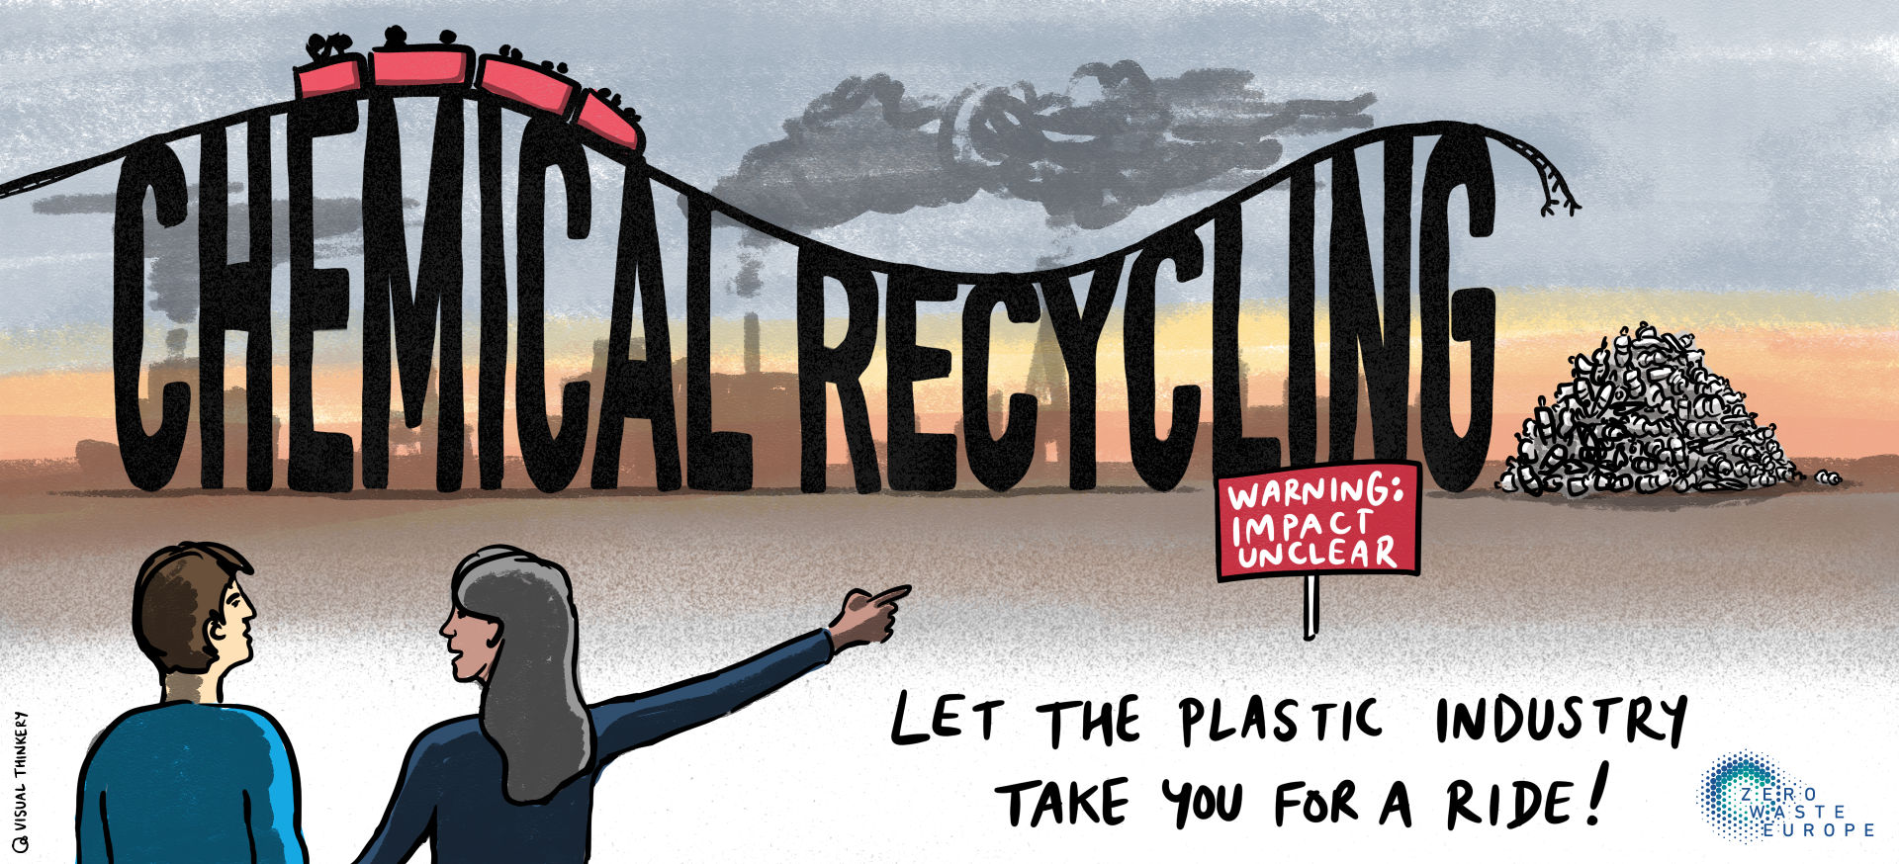
Context

Slide 3
What is ‘Chemical Recycling’?
Lab’ trials in 1950s
Been failing commercially since the 1970s
A collection of concepts, no accepted definition
Molecular not mechanical process
text
Notes:
When did people first hear about chemical recycling?

Slide 4
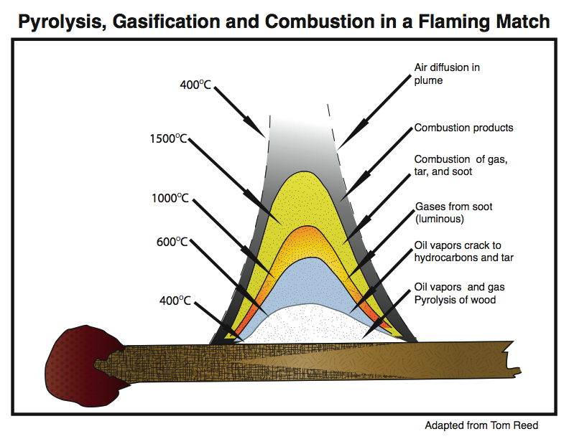
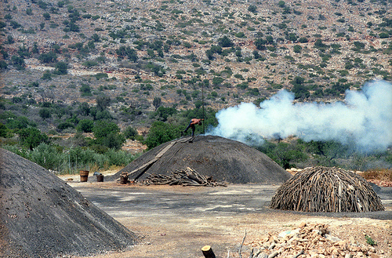
Depolymerisation
Pyrolysis and Gasification
All organic matter when heated without oxygen will release a complex mixture of volatile organic molecules – this is “pyrolysis”
Pyrolysis practised for thousands of years. Gasification technology developed in the 1800s
http://www.gekgasifier.com/info/gasification-basics/gasification-explained
Photo creative commons: Lars plougmann

Slide 5
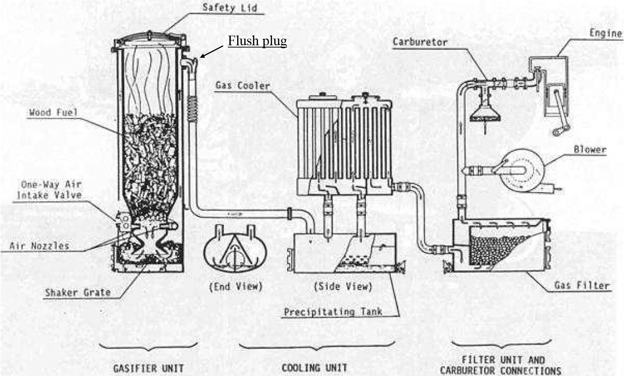
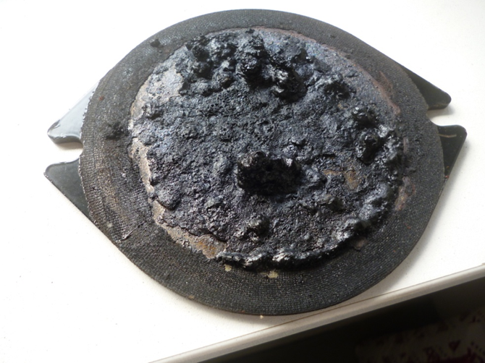
Pyrolysis and Gasification Attempts to manage dirty gases now 100 years old
Incomplete combustion products, most of which are environmental toxins
Polycyclic Aromatic Hydrocarbons (PAHs) – tar and soot
All Pyrolysis and Gasification Reactors produce tar!
Adapted from: LaFontaine, H., Zimmerman, F.P. Construction of a simplified wood gas generator for fueling internal combustion engines in a petroleum emergency, (1989), Federal Emergency Management Agency: Washington.

Slide 6
Solvent-based Technologies
High temperature
Highly solvent specific
Large volumes of toxic waste solvent
Plastic toxins go into solvents and products
text

Slide 7
GAIA
Publications since 2020

Slide 8
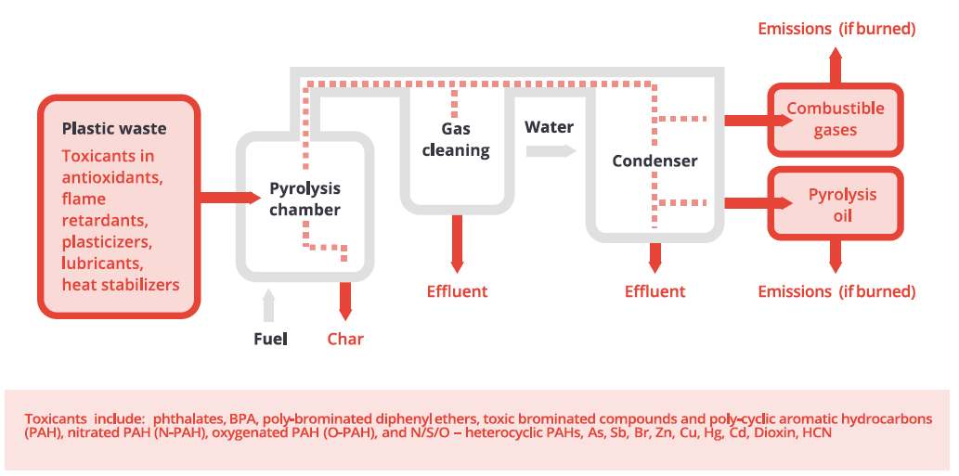
Findings: Environmental Impacts
High energy intensity
High carbon emissions
“Pyrolysis oil should not be used as an energy source”
Mohr et al. 1997
Mohr, K., Nonn, Ch., Jager, J. 1997. Behaviour of PCDD/F under pyrolysis conditions. Chemosphere, 34 (5-7), pp. 1053-1064.

Slide 9
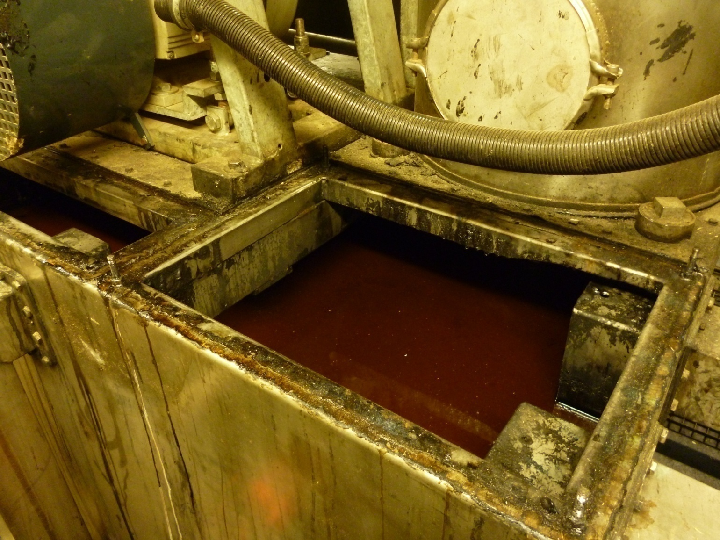
Findings: Environmental Impacts
When plastics decompose it is not simply a reversible process
Unwanted molecules are produced
“All these contaminants are known to cause corrosion issues, increase coke formation, destroy expensive reactor tubes, or deactivate catalysts in the separation section of a steam cracker.” ¹
“In a nutshell, today the quality of crude plastic pyrolysis oils is unacceptable as feedstocks for industrial steam crackers” ¹
1. Kusenberg, M., Eschenbacher, A., Djokic, M.R., Zayoud, A., Rageart, K., De Meester, S., Van Geem, K.M. 2022. Opportunities and challenges for the application of post-consumer plastic waste pyrolysis oils as steam cracker feedstocks: To decontaminate or not to decontaminate? Waste Management, 138, pp. 83-115.

Slide 10
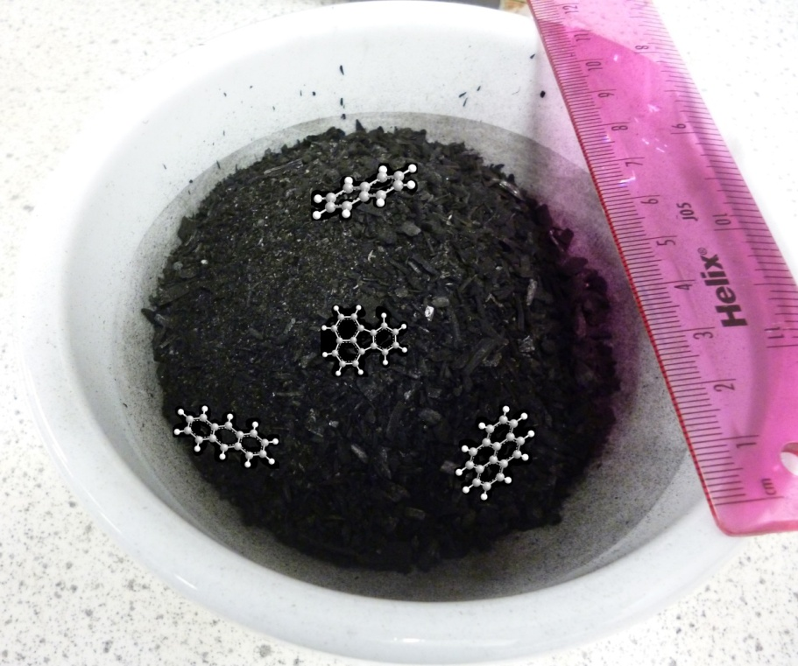
Findings: Environmental Impacts
Presence of banned substances and subsequent need to comply with chemical hazard regulations has been the primary cause of plant closure. ¹
Common for polymer toxins (such as phthalate esters) to transfer into the solvent. ¹
Following a study of plastic pyrolysis, the resultant char was
contaminated with heavy metals (As, Cd, Pb, Cu, Hg, Zn), and classified as both hazardous and ecotoxic. ²
1. Sherwood, J. 2020. Closed-loop recycling of polymers using solvents. Johnson Matthey Technology Review, 64, pp. 4-15
2. Bernardo, M., Lapa, N., Gonçalves, M., Bardosa, R., Mendes, B., Pinto, F., Gulyurtlu, L. 2010. Toxicity of char residues produced in the co-pyrolysis of different wastes. Waste Management, 30, pp. 628-635.

Slide 11
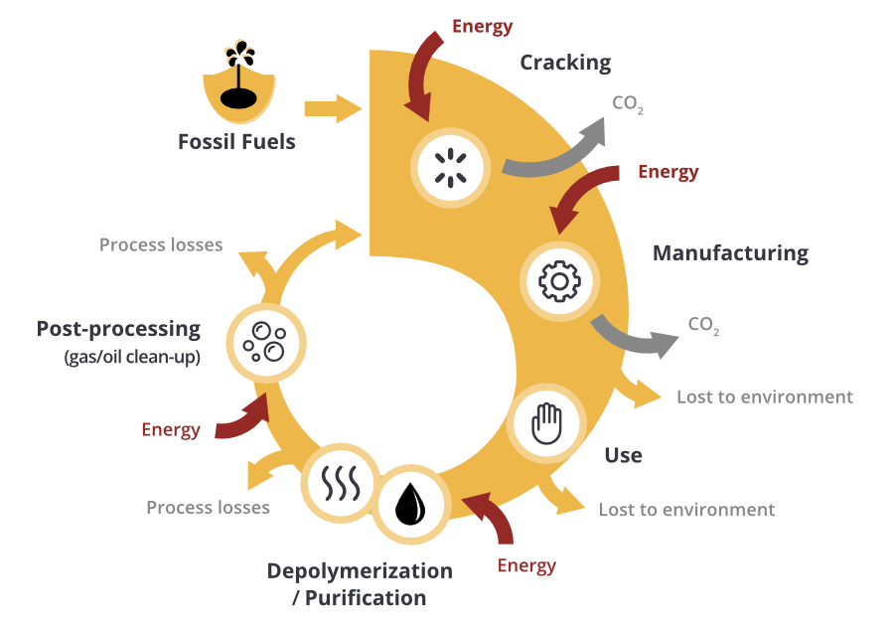
Findings: Energy
The leaky circular economy in plastics
High fossil fuel consumption
Little plastic makes the round trip
“No chemical recycling technology can offer a net-positive energy balance, even if the products/by-products are burned for energy” ¹
1. Baytekin, B., Baytekin, H.T., Grzybowski, B.A. 2013. Retrieving and converting energy from polymers: deployable technologies and emerging concepts. Energy and Environmental Science, 6, pp. 3467- 3482.

Slide 12
Greenpeace
“All of the plastic-to-plastic projects are considered to be of questionable viability or potentially unviable”.

Slide 13
World Wildlife Fund
“...there are significant concerns that these technologies are energy intensive [and] pose risks to human health”

Slide 14
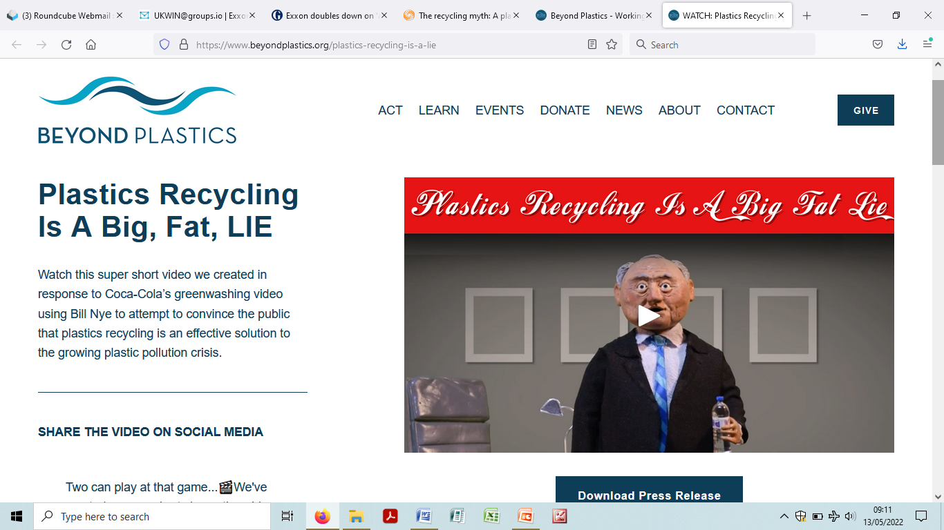
Beyond Plastics
“...this energy intensive process creates toxic air pollution and speeds up climate change”
https://www.beyondplastics.org/plastics-recycling-is-a-lie

Slide 15
National Resources Defense Council
Reviewed eight ‘chemical recycling’ facilities in the U.S.
The majority of facilities are not recycling any plastics
The facilities generate large quantities of hazardous waste
They release hazardous air pollution

Slide 16
National Resources Defense Council ‘Recycling Lies’
Hazardous waste sent off-site by Agilyx:
Lead, cadmium, selenium, benzene, chromium, vinyl chloride, barium.
Hazardous air pollutants associated with multiple facilities:
Styrene, benzene, toluene, mercury, arsenic, dioxins, ethyl benzene, xylene, naphthalene, acetaldehyde, formaldehyde, hydrochloric acid, hexane.

Slide 17
Industry
“…the pellet yield is only around 22 per cent of the original input material.” (Veolia Executive ¹)
1
1
‘It would be “optimistic” to suggest that chemical recycling will become a viable outlet for waste plastics inside the next decade’ ²
2. Doherty, J. 2019. Chemical recycling of plastics '10 years away' (online). Accessed 2nd June 2022. Available from: https://www.letsrecycle.com/news/latest-news/chemical-recycling-ofplastics-10-years-away/

Slide 18
Conclusions
No evidence that chemical recycling is ‘Environmentally sound’. All evidence is to the contrary
Energy balance is negative. Climate impacts
Fifty years of commercial failure
Large quantities of toxic residues produced
Toxins go into products and by-products
The operating facilities recycle little or no plastics
Lock in to decades more fossil fuel consumption...
...hence heavily promoted by petrochemicals industry

Slide 19
Thank you for joining us!
Get in touch
Dr Andrew N Rollinson: Andrew@blushfulearth.co.uk
For media inquiries: claire@no-burn.org
Follow us on social
Global twitter: @GAIAnoburn
Global facebook: @GAIAzerowaste
Asia Pacific twitter: @ZeroWasteAsia
Asia Pacific facebook: @GAIAAsiaPacific
US/Canada twitter: @GAIAUS_CAN
US/Canada facebook: @GAIAUSCAN
Zero Waste Europe twitter: @ZeroWasteEurope
Zero Waste Europe facebook: @ZeroWasteEurope
Read more at www.no-burn.org

